Slide 1
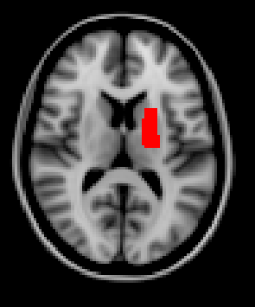
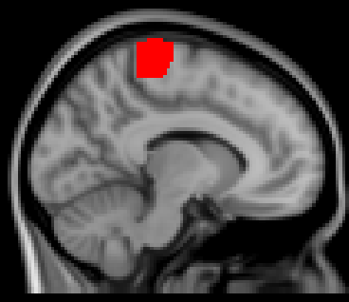
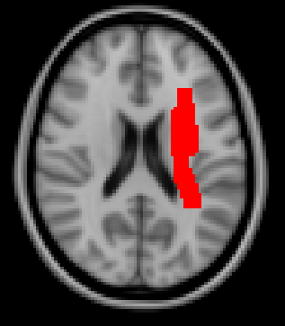
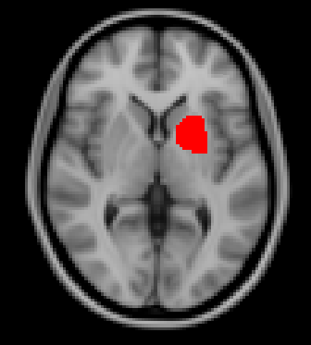
1. Michael Phelps - Subcortical stroke; Upper limb hemiplegia with spasticity
2. Harvey Specter – Cortical stroke;
Lower limb impairment
Harvey, while arguing with Jessica over a supreme court case, suffered a cortical stroke near the primary motor cortex. He has lower limb impairment, where he has slight gait asymmetry. He is attending rehab, but constantly wants updates on his progress after each session. He also read that running on the treadmill can improve muscle performance and he pushes himself harder than what is recommended so that he can get back to being a corporate shark.
Michael Phelps suffered a right subcortical stroke in the internal capsule, the main motor tract. He now has upper limb hemiplegia with spasticity and is distraught that he will not be able to win his 24th gold medal in Tokyo 2020. He is so upset that he barely pays attention while you, his rehab team, try to explain and run through his rehab strategy.
3. Meredith Grey – Middle cerebral artery stroke; Upper and lower limb impairments
4. Betty White – Basal ganglia stroke; Asymmetric gait
Dr. Meredith Grey feels sorry for herself because she got into an accident and she feels that the universe is out to get her. She thinks that she should just stay in bed so that nothing else bad will happen to her, despite her medical degree where she learned about stroke and the importance of rehab. You worry she is showing signs of depression after her injury.
Betty White keeps trying to make jokes while you, her rehab team, try to administer therapy. She doesn’t seem to take anything seriously and it doesn’t seem like she practices any of the rehab activities at home, like she says she does.

